Slide 1
So you want a Call Tree
Graph Updates

Slide 2
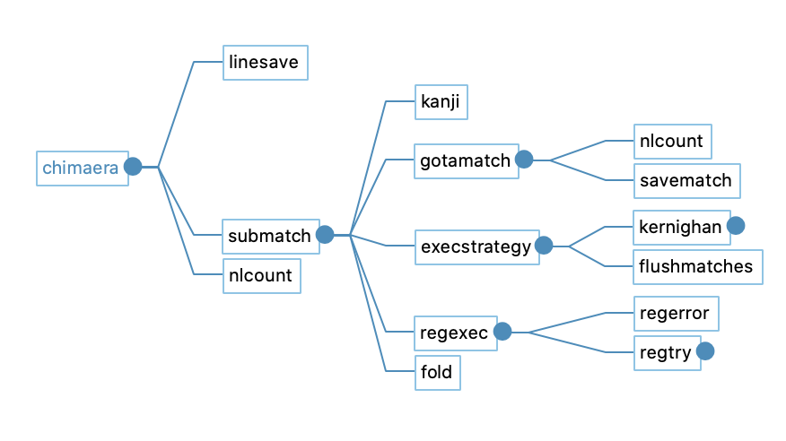
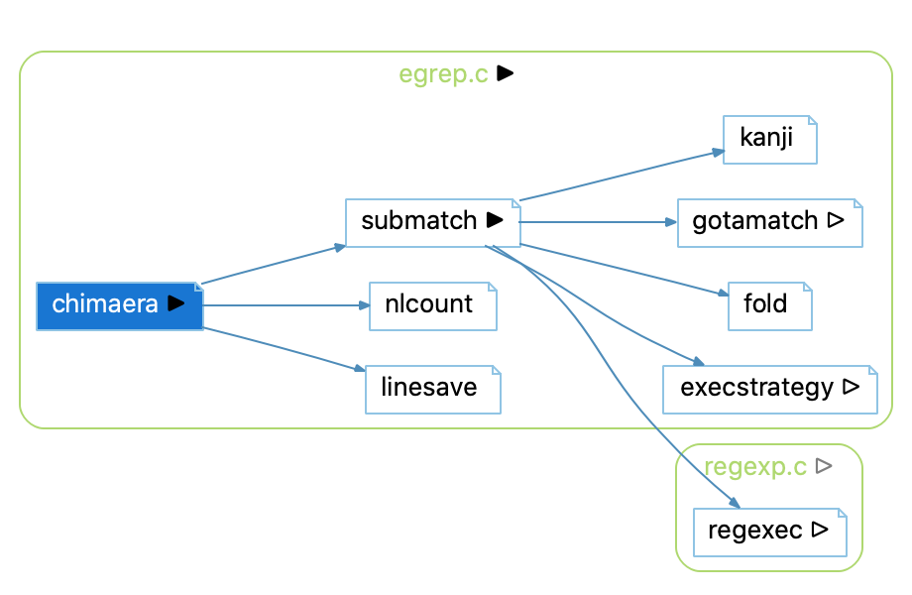
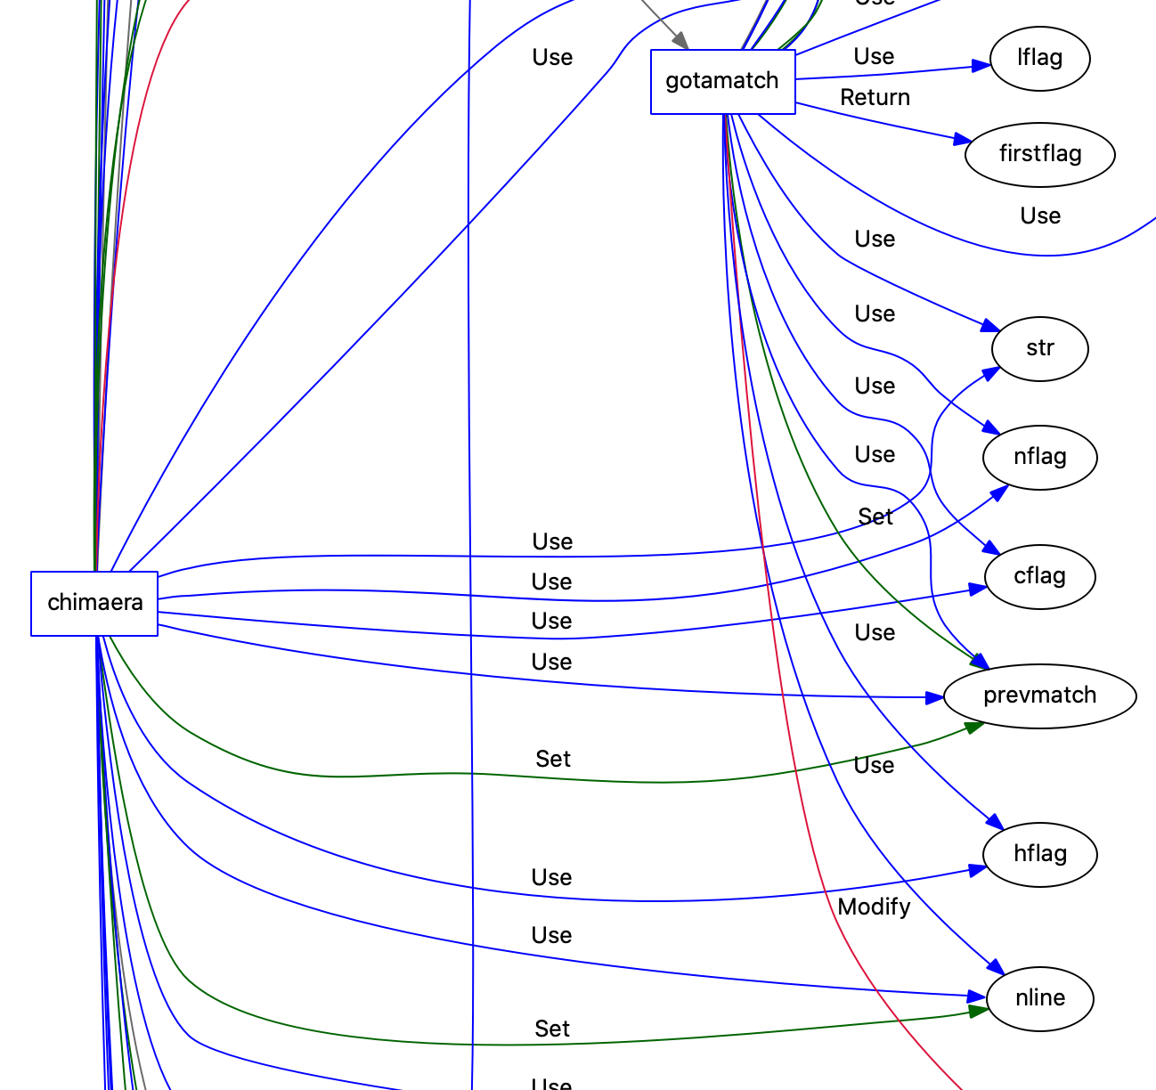
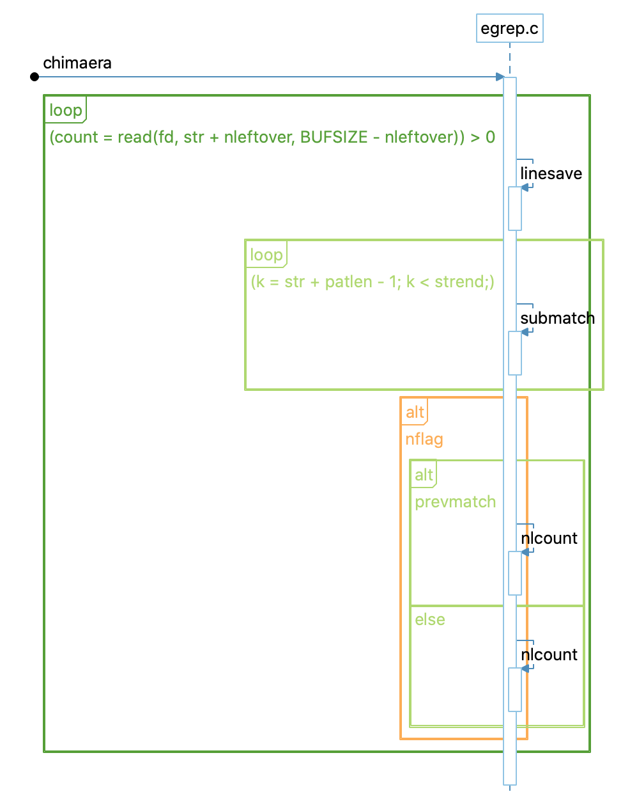
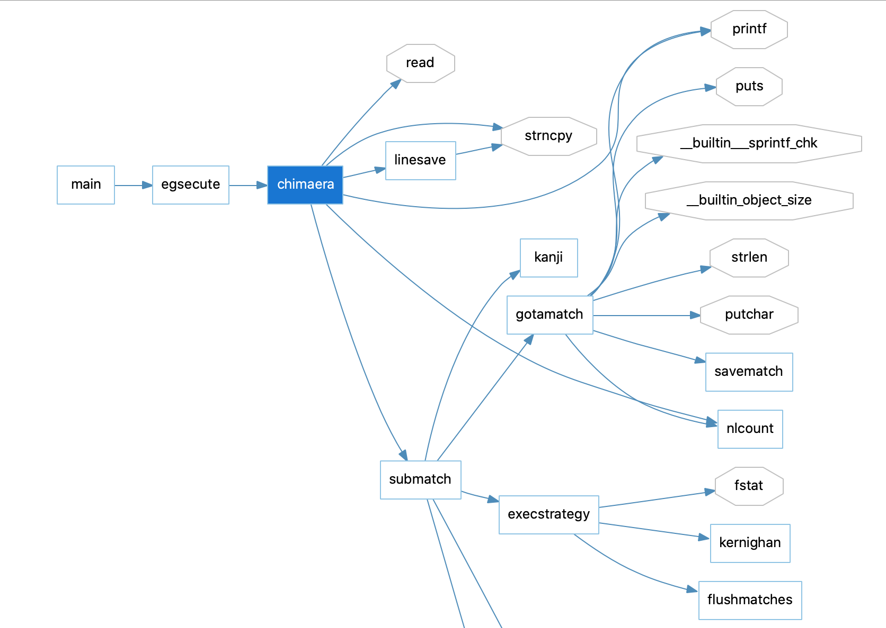
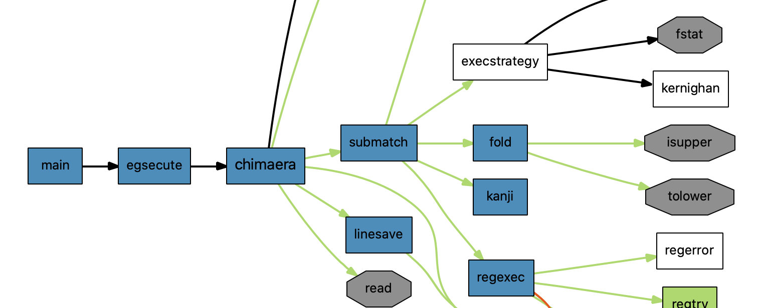
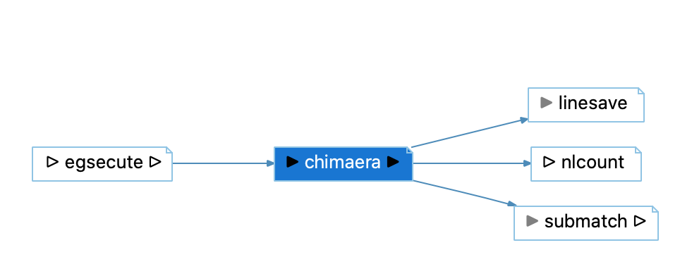
Have you ever been overwhelmed by the number of ”Calls” graphs in Understand?
b
a
c
Calls graphs for the function Chimaera in the Fastgrep sample project.
Graphs with ”Calls” in the title: (a) a Calls graph. (b) Calls Relationship with regerror. (c) Cluster Call. (d) Calls with Global Objects.
Graphs that turn out to also show calls: (e) UML Sequence Diagram. (f) Butterfly (g) Cluster Call Butterfly (h) Compare Butterfly
d
e
f
h
g

Slide 3
We want to make it simpler.
Old Way: Graphical Views shows all possible graph variants
New Way: Graphical Views shows possible relationships. Graph variants are picked from the Graph Window.

Slide 4
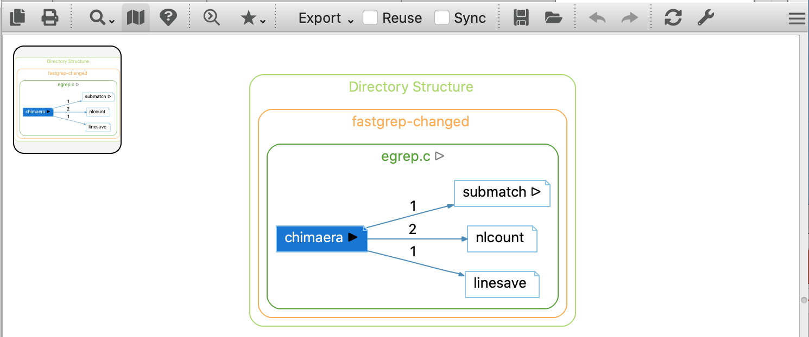
Did you notice some other changes in the Graph Window?
Old
Fun side note: My boss used to send me comparison pictures all the time when we were working on window restoration. His two-monitor spreads with zillions of window positions to reproduce were monstrous, but at least he played “Spot the Difference” for me and had them all helpfully identified. Solutions for this “Spot the Difference” are in the following slides.
New

Slide 5
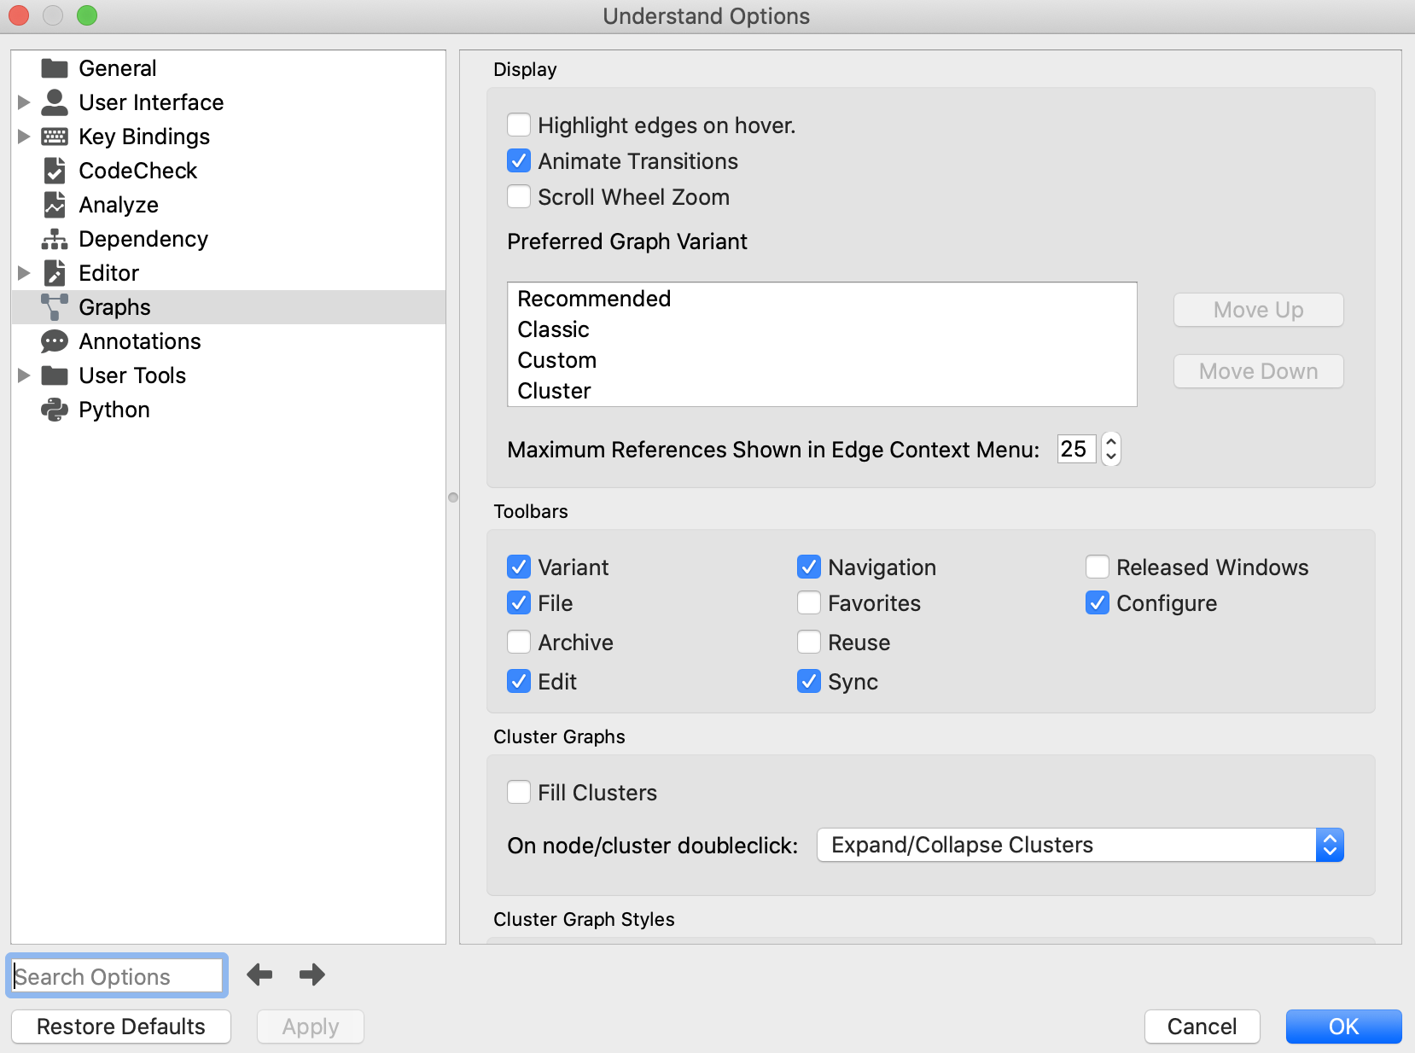
If you feel like the new toolbar is missing some options, don’t worry. It’s customizable.
Variant: Select a graph variant
Favorites
Sync
Navigation:
Zoom
MiniMap
Legend*
Search
Reuse
File:
Copy to clipboard
Print
Save¹
Released Windows
Configure:
Opens This Dialog²
Starred (*) options are only available for some graph variants.
1. Save supports all export formats available from the old Export menu (png, jpg, svg, vdx, dot*).
2. Dialog can also be opened from the Tools->Options menu (Windows) or Understand->Preferences (Mac)
Archive:
Save to Database*
Load from Database*
Edit Visible Toolbars Here
Edit:
Undo
Redo
Restore Defaults*

Slide 6
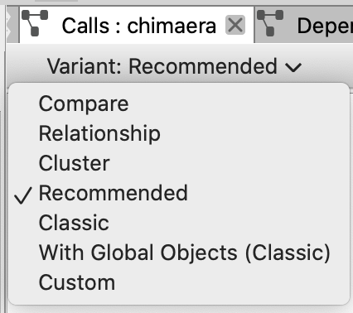
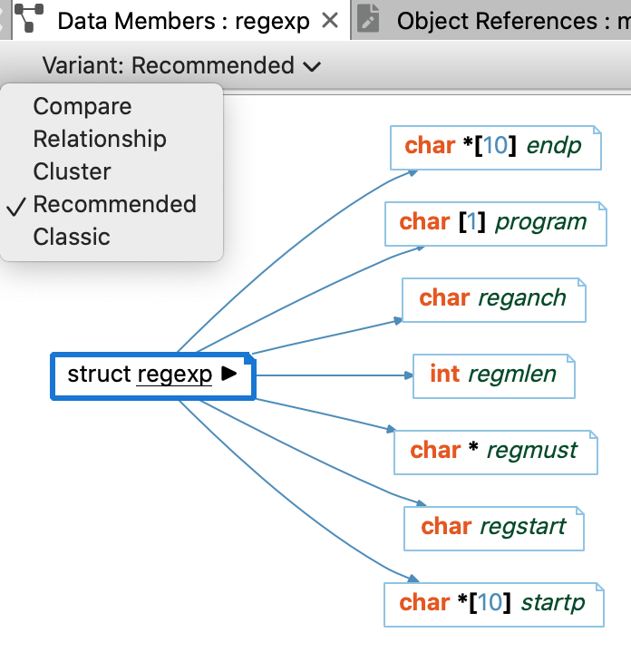
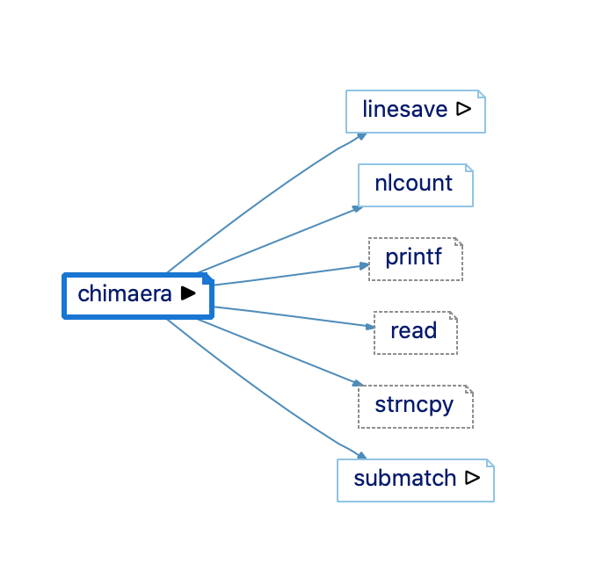
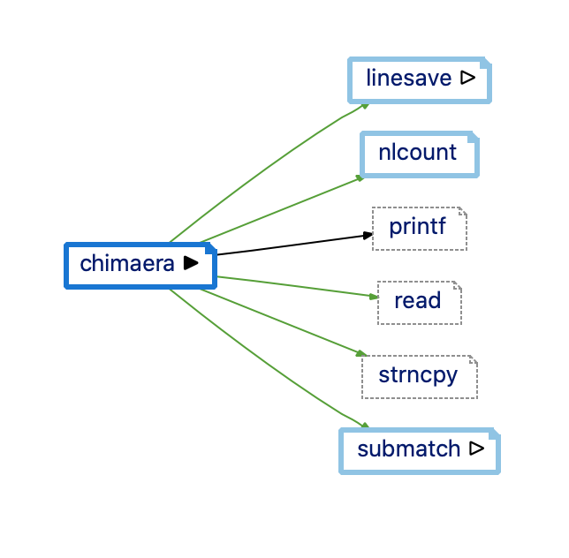
A closer look at: VARIANTS
New!
New!
New!
-> Calls Relationship
New!
-> Cluster Call
New!
New!
-> Data Members
-> Calls
-> Calls with Global Objects
-> User plugins default to “Custom”
For the Calls graph, some variants are mappings from previous graphs, but there are two new variants: Recommended (a) and Compare (b).
And, ALL tree graphs (except dependency graphs) have the same variants, adding many new graphs!
a
b

Slide 7
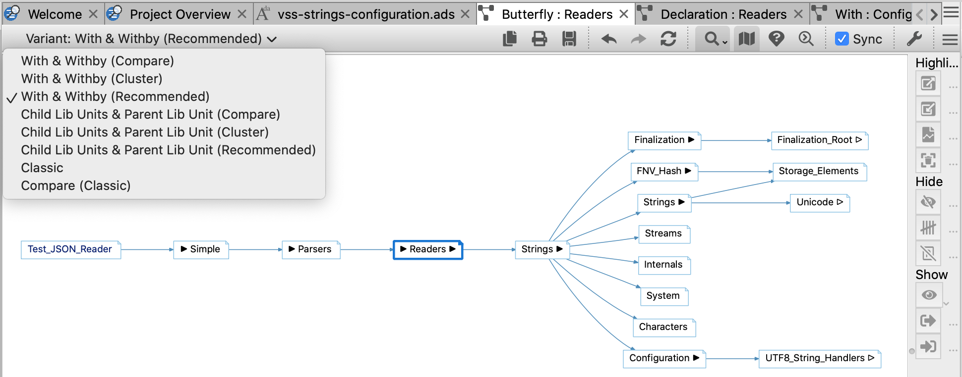
A closer look at: VARIANTS
New!
-> Cluster With Butterfly
New!
New!
New!
-> Butterfly
New!
-> Compare Butterfly
New Butterfly Graph variants have also been added.
Pick between Butterfly relationships when multiple exist (the sample graph is from the AdaCore VSS project).
Butterfly edge indicators have been simplified so edges in the right tree can only be expanded to the right and edges in the left tree can only be expanded to the left.

Slide 8
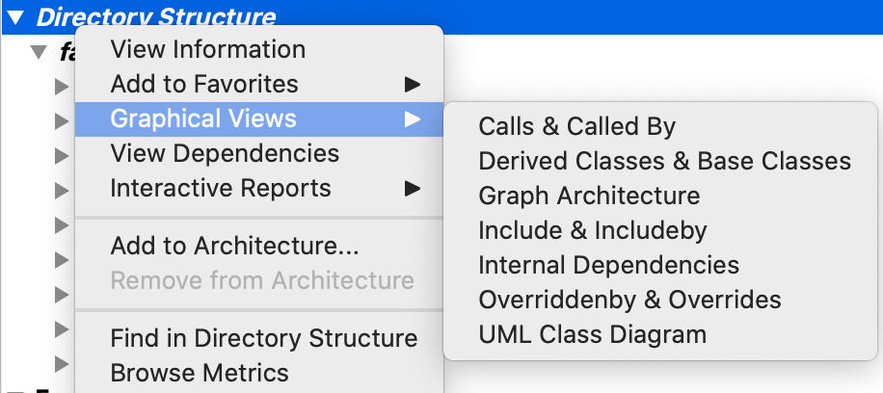
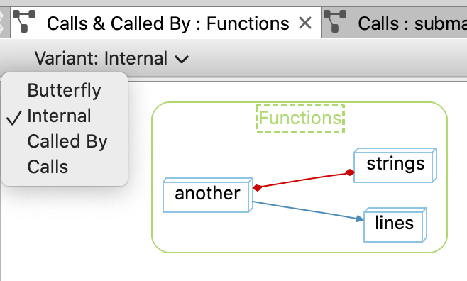
A closer look at: VARIANTS
-> See Below
New!
New!
New!
New Cluster graphs have been added. Previously, only calls and dependencies could be graphed at an architecture level. Now most relationships shown in Butterfly graphs are also available at an architecture level!
Architecture graphs are determined solely by languages in the project and might not always have content.
Cluster Call Butterfly <-
Cluster Call Internal <-
Cluster Callby <-
Cluster Call <-

Slide 9
A closer look at: STYLES
Did you notice some style differences? For example, the root node used to be filled, and now it only has an outline. Why? Because there are new text options!
Many graph variants now support styled labels that use the editor styles to color text (styled labels are not available from graphs exported from the API).
The global style has also been updated to better show unresolved entities and global objects.
These are clickable links

Slide 10
A closer look at: UNDO and REDO
Have you ever opened a graph, tried to scroll, and accidentally zoomed instead. This used to be fixable only by going to the zoom menu and setting the zoom back to 100%. Then, for good measure, opening Graph Configuration and turning off “Scroll Wheel Zoom” (yes, that’s an option. Hold down Ctrl to temporarily switch modes).
Now, zoom is undo-able. And not just zoom:
Switched to a new graph variant? You can undo that.
Switched to a new graph with sync? Undo that too.
Changed a graph option with the context menu? No problem.
Re-using the same graph window? Ctrl+Z is your friend.

Slide 11
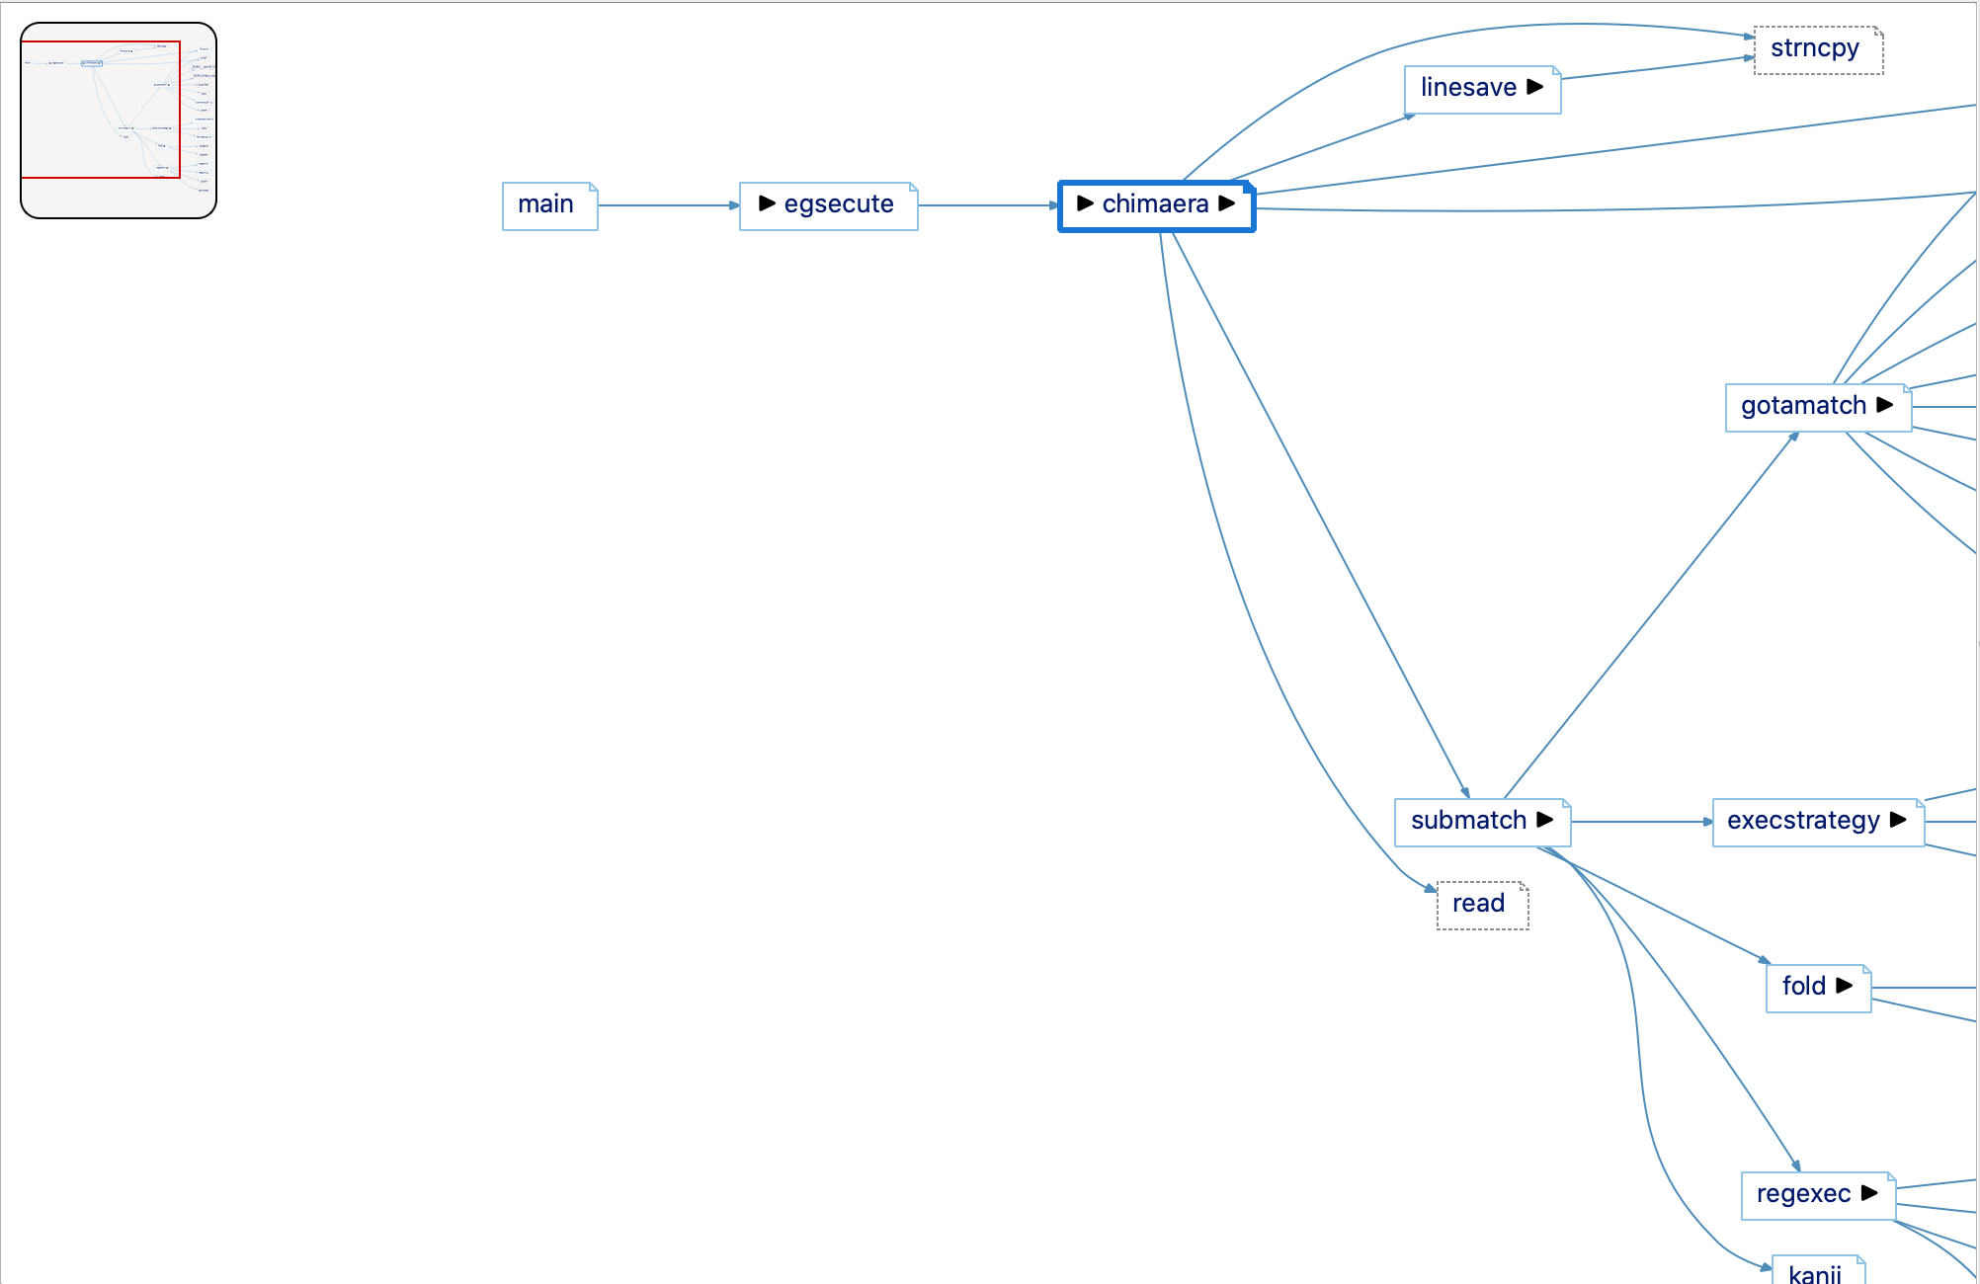
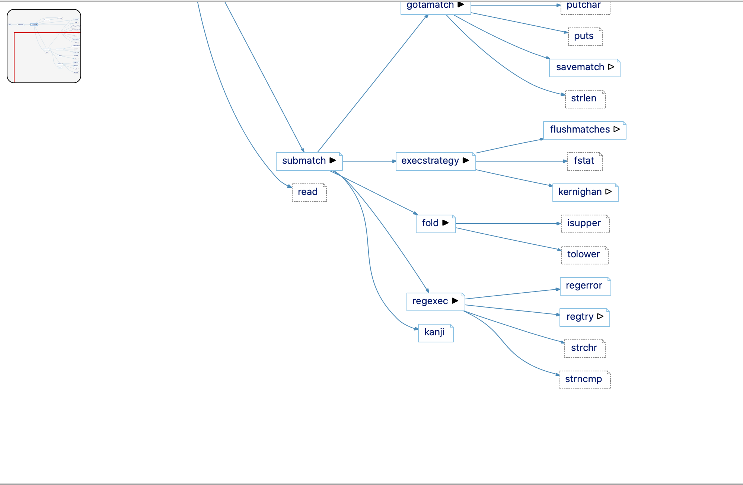
A closer look at: the MINIMAP
Click to Center the View on that Point
Ctrl+Click to move the Minimap
Ever tried to click in the Minimap to navigate? You weren’t the only one who was disappointed. But you’ll be disappointed no more. Hold down Ctrl to move the minimap with click and drag. Otherwise, clicks and click and drag will now update the viewport:

Slide 12
Summary
Already released:
Improved scroll wheel zoom
Changes to the default navigation
All graphs animated (highlight edges on hover is available for all graphs)
Highlight path to selected nodes is now a node option that works with the hide unhighlighted nodes/edges options.
Cluster Call graphs support global objects and unresolved entities.
Minimap
With this release:
Customizable graph toolbar, similar to the editor toolbar
Graph Variants = a lot more graphs. Recommended, cluster, compare and relationship versions for tree-like graphs. More Butterfly Graphs. More relations supported as cluster graphs from architectures and files.
Simpler butterfly graph edge indicators
Updated Architecture Graph
Updated graph style
Rich text labels available in more graphs
Annotations in labels instead of only in hover text for most graphs
Graph undo/redo handles many more features
Graph positioning (artistic style) – see the blog
Minimap click navigation

